Slide 1
Better Beer
Michelle Yeager, Ryan Jenks, Peter Talen, Kindra Evensen, Mollie White

Slide 2
Data Sources
Thanks for the data
The following sources contributed to our research.
Brewer’s Association
DenverGov.org
Promoting independent brewers and craft beer enthusiasts.
Organized dataset about criminal offences in the City and County.
Open Brewery DB
BreweryDB
Free database and API for public information on breweries, etc.
An updated database of breweries, beers, beer related events.

Slide 3
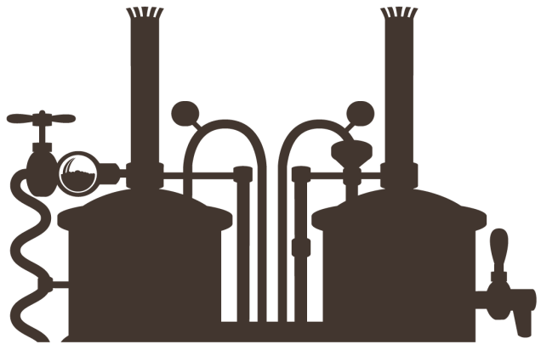
01.Breweries Per Capita
Beer Summary
How many breweries are there in America?
02.Brewery Popularity
How do states differ with popularity? What growth has the industry seen?
03.Colorado and Denver Breweries
Where does Colorado fall in comparison with other states?
04.Breweries and Crime
Are misdemeanors more common near breweries?
05.Beer types, IBUs, ABVs 5
What are the physics of beer? What words are most commonly used in describing beer?

Slide 4


BEER
Breweries per capita
6,266 Breweries
Vermont has the highest number of breweries per capita at 11.5
Mississippi has the lowest number of breweries per capita at 0.6
Colorado ranks fifth with 8.4 breweries per capita
* Brewery count is as of 2017

Slide 5
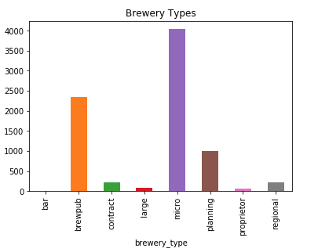
Brewery Types
Brewery DB’s classifies breweries as: bar, brewpub, contract, large, micro, planning, proprietor, regional.

Slide 6
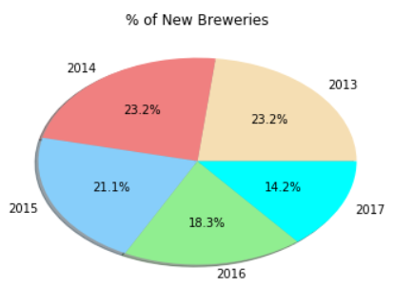
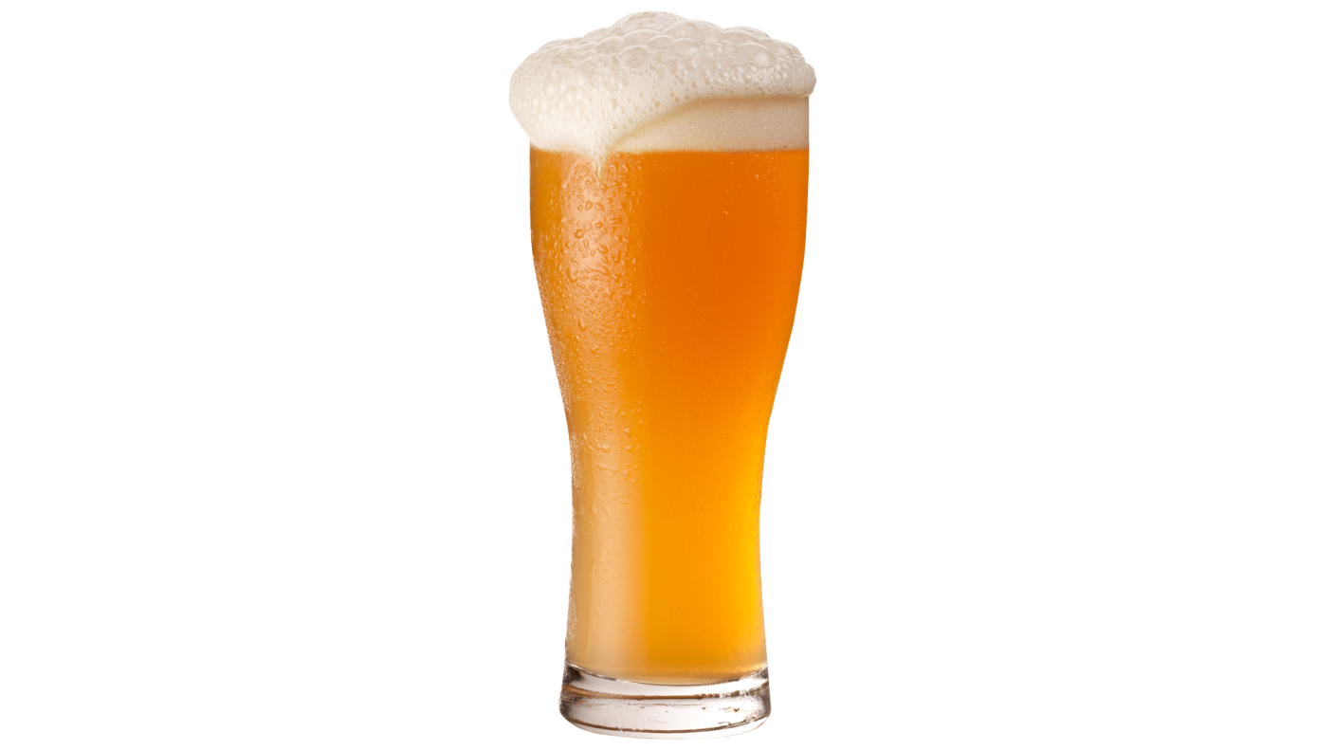
Newly Established Breweries
Which years saw more growth in breweries?
510 2013
510 2014
465 2015
403 2016
312 2017

Slide 7
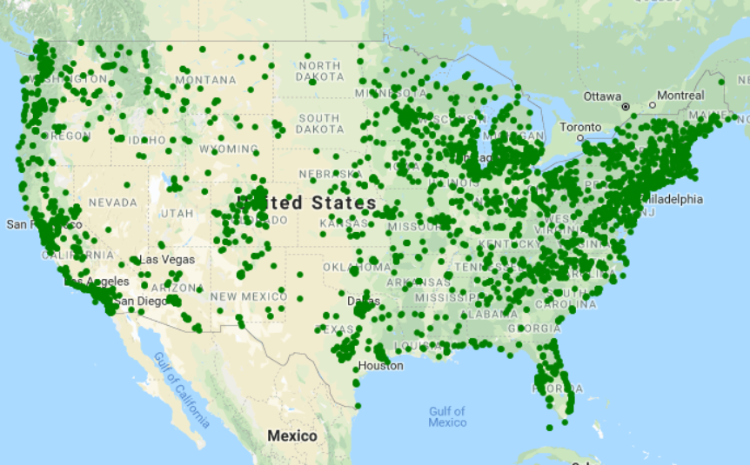
US Breweries
Plot map of breweries

Slide 8
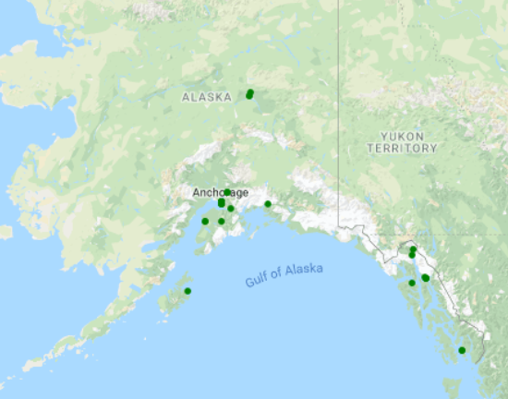
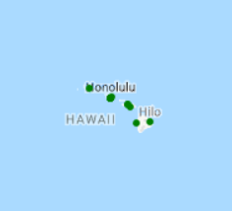
Alaska and Hawaii

Slide 9
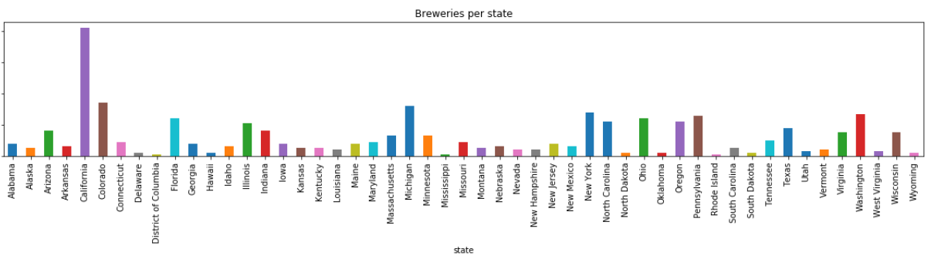
Breweries per State
Count of breweries
Data from Openbrewerydb.org
Immense Visual Appeal
We create power point templates based on new visual trends that’s fresh, relevant and always on the cutting edge.
Eye-Catching Visual
We create power point templates based on new visual trends that’s fresh, relevant and always on the cutting edge.
* Brewery count is as of 2018

Slide 10
Most and Least
Breweries by state
While Vermont has the highest breweries per capita, who has the overall most?
Colorado
Most Breweries
California has 764 breweries
Least Breweries
Mississippi has 12 breweries
* Brewery count is as of 2018

Slide 11
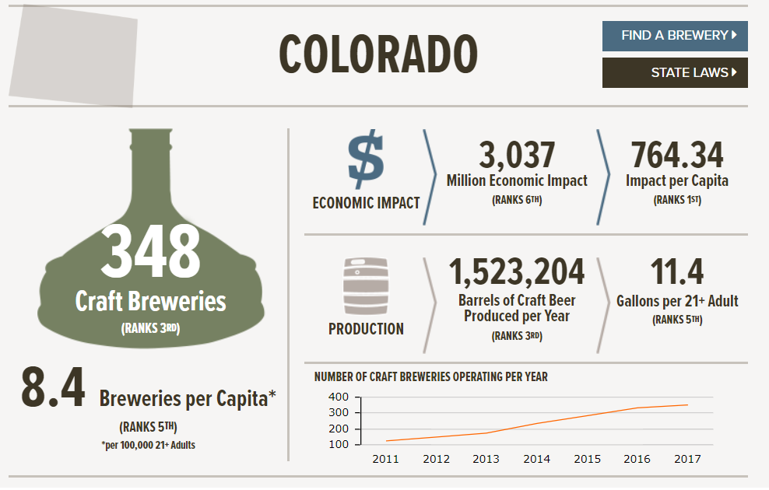


Colorado’s Ranking
*Data from brewersassociation.org
Text box

Slide 12
Top Five
Per city and state
Top Five States
States | Number | Ranking
California | 942 | 1st
Colorado | 439 | 2nd
New York | 428 | 3rd
Washington | 405 | 4th
Michigan | 381 | 5th
Top Five Cities
Cities | Number | Ranking |  | State
Portland | 106 | 1st |  | OR
San Diego | 94 | 2nd |  | CA
Denver | 93 | 3rd |  | CO
Seattle | 72 | 4th |  | WA
Chicago | 65 | 5th |  | IL
* Brewery count is as of 2018

Slide 13
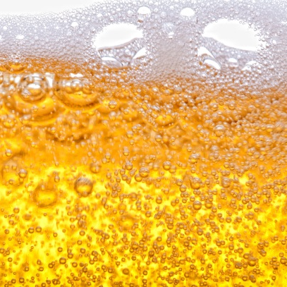
Most Popular Cities
Top Five
Denver made the cut!
Chicago
Portland
Cities
Seattle
San Diego
Denver

Slide 14
Most Popular Cities
Top Five
Google’s API returns these five breweries as Denver’s “best breweries”
Google
&
Denver
Wynkoop Brewing
Denver Beer Co
Jagged Mountain
Epic Brewing
Great Divide

Slide 15
Breweries and Crime
Is there a positive correlation between beer and neighborhood crime?
We compared Denver’s breweries by zip code next to crime by zip code.
Breweries
Crime
Year Round Brewery Weather in Denver

Slide 16
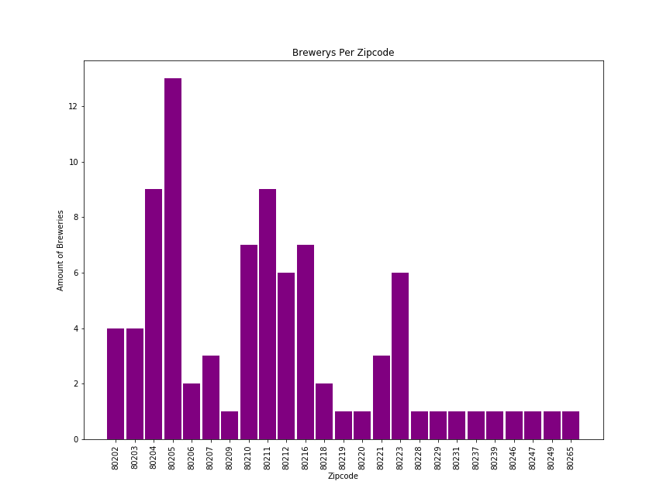
Breweries in Denver
Per Zip Code

Slide 17
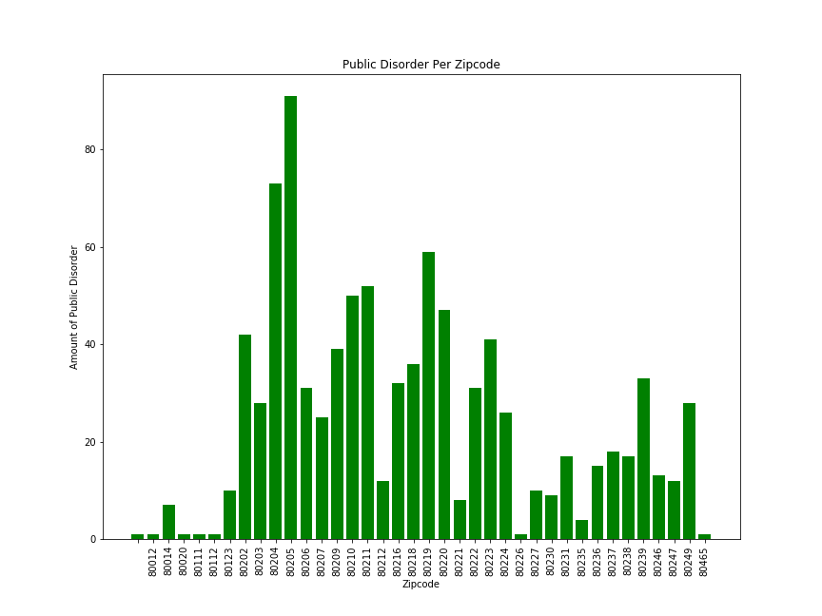
Public Disorder in Denver
Per Zip Code

Slide 18
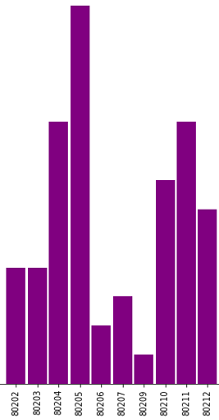
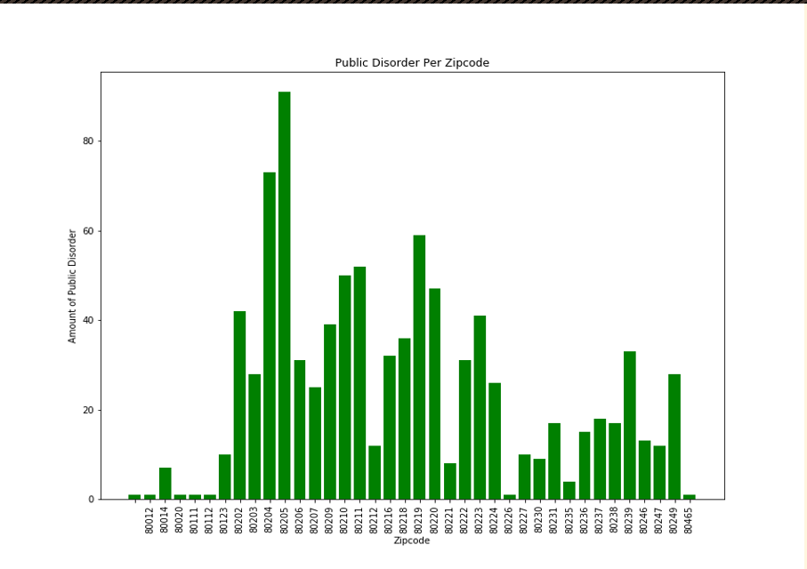
Ten Zip Code Comparison
More breweries, more crime?
Breweries
Crime
Did the breweries bring
the crime?

Slide 19
The Physics of Beer
What are all those beer Acronyms?
All you need to know about beer
International Bitterness Units
Temperature, moisture, content
SRM
ABV
IBU
Density
Standard Reference Method
Alcohol measured By Volume

Slide 20
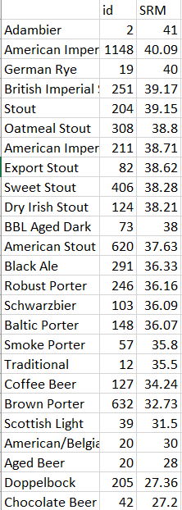
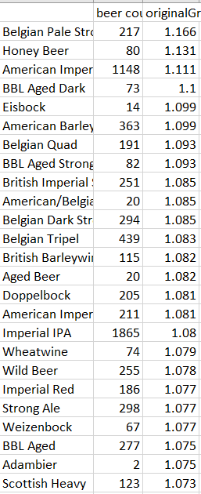
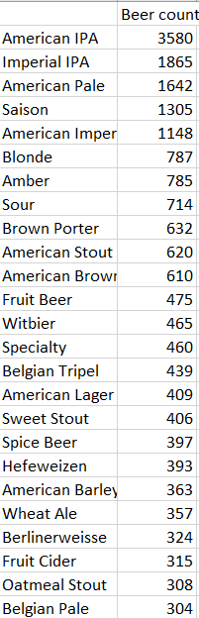
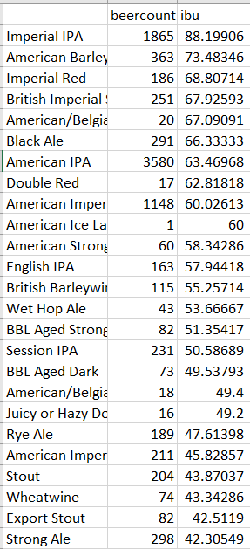
The Data
Most Popular
Density
Popularity
Beer by IBU

Slide 21
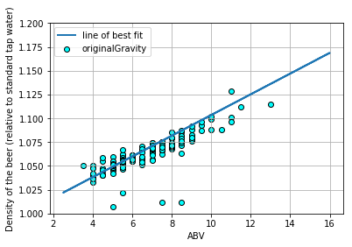
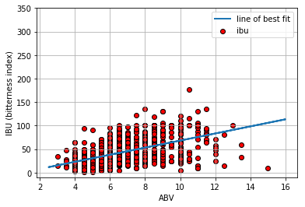
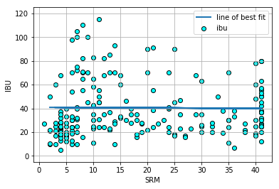
Beer Statistics
Which beers have the greatest density and IBU?
Density by ABV
IBU by ABV
IBU by SRM

Slide 22
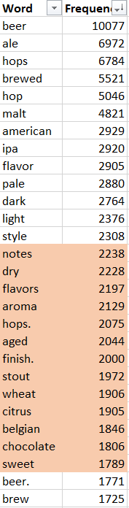
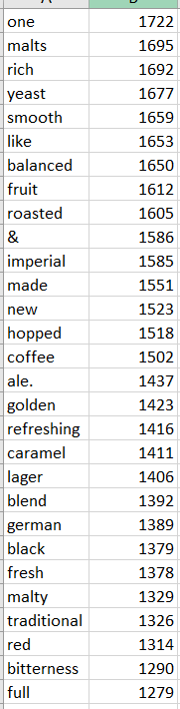
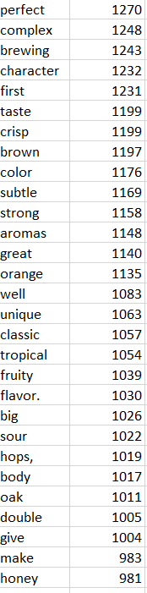
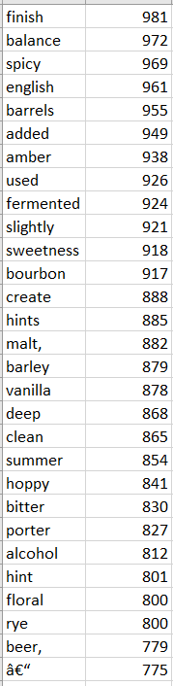
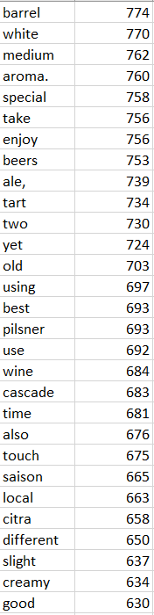
Data Mining

Slide 23

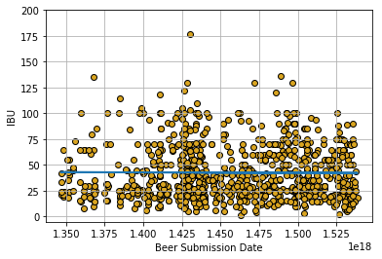
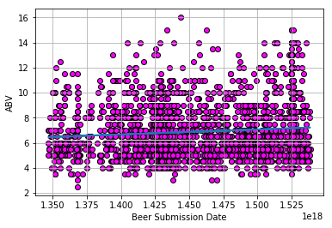
IBU and ABV
Tracking IBU and ABV Over Time

Slide 24
Conclusions
We like beer!
After analyzing the data sets, we found the following conclusions:
Better Beer Conclusions
Popularity
Crime
Physics
Breweries and the people who love them are at an all time high. While new growth as slowed, it doesn’t appear the love of beer has stalled out.
There is a slight correlation between zip codes that house a high number of breweries and petty crimes. Population density might play a role.
Many factors are used in judging beer including ABV, IBU, SRM, time, temperature, and ingredients - like hops, water, and barley.

Slide 25
Additional Topics
What would we research further with two weeks?
A few items that piqued our curiosity…
01
Seasons and Beers
Are different styles of beer more popular seasonally?
02
Brews by Political Affiliation
Are there more breweries in areas that are strongly affiliated to one party or another?
03
Population Density
What would we find if we spent more time looking at density within the City or State?
02
Median Income
Are breweries found regularly in areas with higher or lower incomes, or lower areas of rent?

Slide 26
Cheers!
October 10, 2018 by Michelle Yeager, Ryan Jenks, Peter Talen, Kindra Evensen, Mollie White

